Slide 1
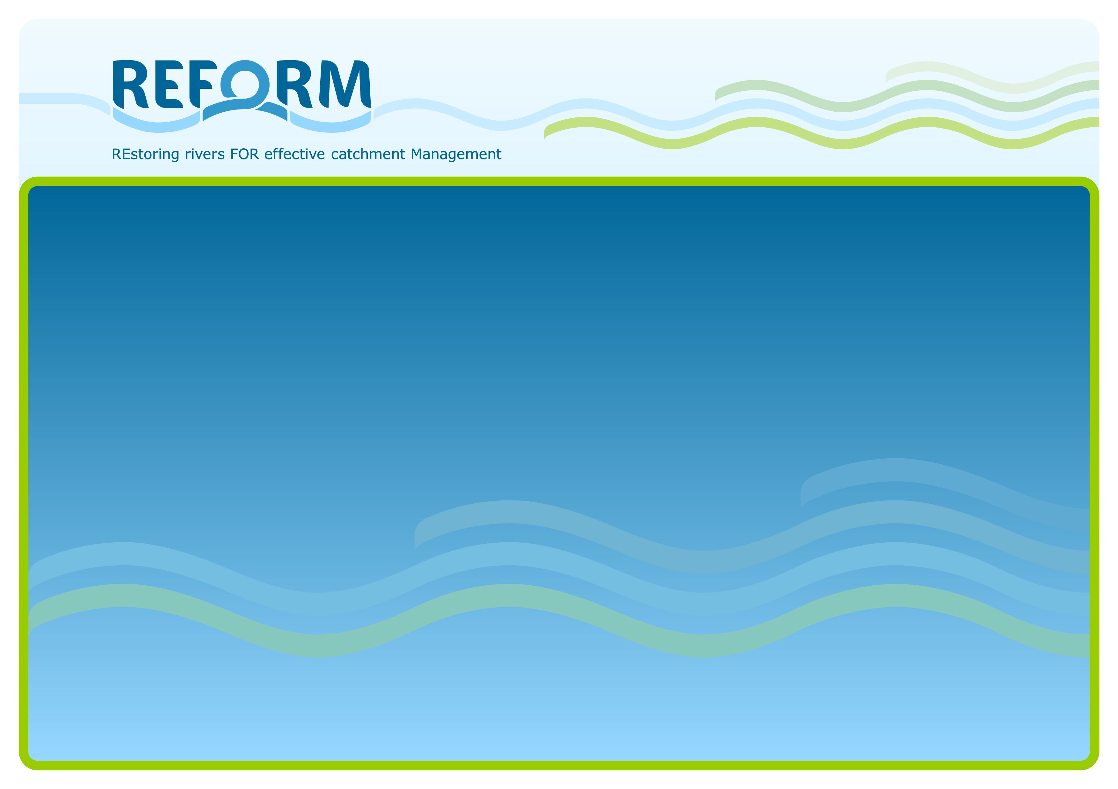
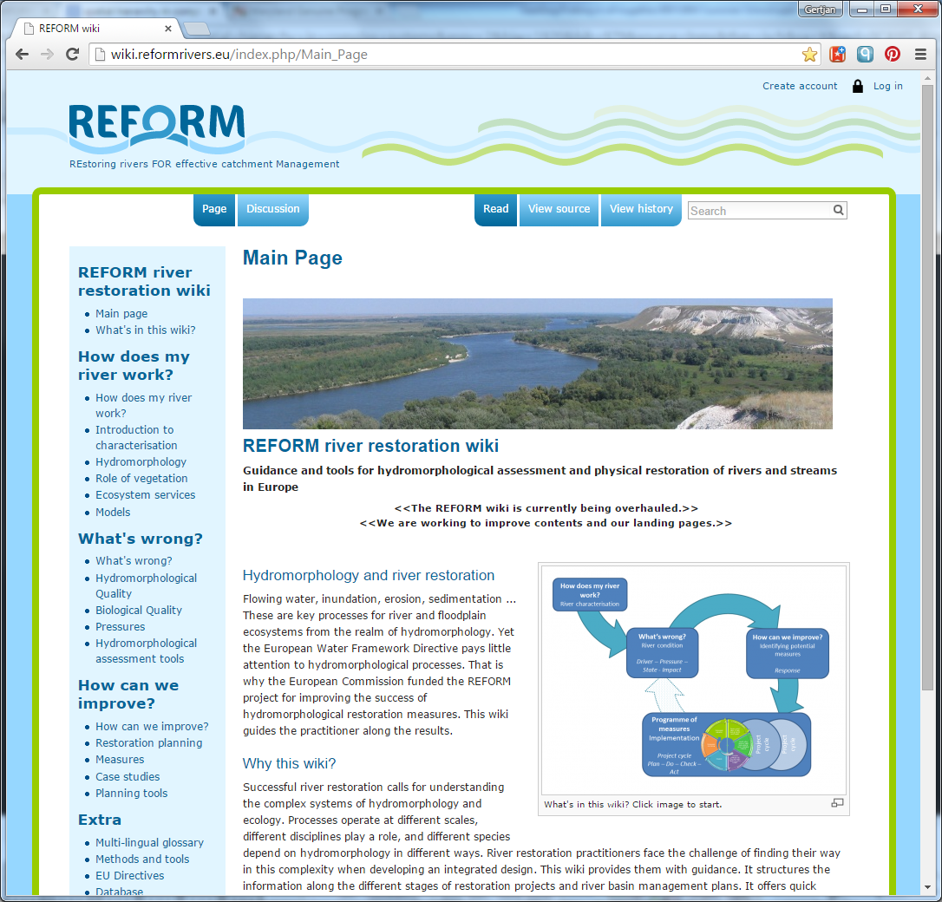
Recap of the key REFORM steps for effective river restoration
See also (wiki.)reformrivers.eu
Gertjan Geerling
Deltares / Radboud University, Nijmegen
gertjan.geerling@deltares.nl

Slide 2
Key REFORM components (taken from wiki.reformrivers.eu)
Notes:
The “Catchment Planning Cycle” as shown on the wiki.reformrivers.eu. It shows the 4 key steps in catchment planning in layman words: How does my river work?; What’s wrong?; How can we improve?; Programme of measures (detailed planning and implementation). This is at the same time the structure of this lecture.

Slide 3
How does my river work?
Notes:
The first step “How does my river work?” has been shown today in presentations of Angela Gurnell and Massimo Rinaldi. A short recap is shown in the following slides.

Slide 4
THE REFORM HYMO FRAMEWORK: AIMS
to develop understanding of the space-time controls at region to reach scales on river reach hydromorphology
to understand how reach hydromorphology has responded to processes and human interventions in the past and present and may respond in the future to a variety of likely scenarios
to support development of sustainable management / rehabilitation solutions for river reaches that work with river processes in the context of human constraints.
Source: REFORM Summer school lecture A. Gurnell
Notes:
The aims are important to understand and fundamental to successful river rehabilitation / restoration, Angela Gurnell writes:
“The REFORM framework aims to help river managers develop understanding of the controls on the hydromorphology (i.e. hydrology and fluvial geomorphology) of rivers across spatial scales from biogeographical region to reach and to track how those controls and their consequences for the river system change through time.
This space-time framework allows integrated understanding of how changes in both human interventions and pressures, and hydromorphological processes affect individual reaches, providing a basis for forecasting the likely impact of future change scenarios.
Such understanding provides a firm basis for developing sustainable river management solutions.”

Slide 5
THE REFORM HYMO FRAMEWORK: 1. DELINEATION
Region: Biogeographical region (climate-vegetation).
Catchment: enclosed by watershed
Landscape unit: topography, geology, land cover
Segment: major changes in gradient, catchment area, valley confinement
Reach: consistent planform / features, bounded by major artificial longitudinal discontinuities.
Region
Catchment
Landscape unit
Segment
Reach
Geomorphic unit
Hydraulic unit
River element
Source: REFORM Summer school lecture A. Gurnell
Notes:
Angela Gurnell:
“First the spatial units that underpin the analysis are delineated.
The biogeographical region in which the catchment is located dictates the broad climate regime and the range of potential vegetation types and species that the catchment may contain.
The catchment to reach units are defined using a standard set of criteria. For example, landscape units are areas defined by their broad elevation and relief characteristics, and their assemblage of rock types and land cover types.
Pan-European data sets are available to support delineation of the spatial units if suitable national data sets are not available.
The units are nested within each other so that, for example, one landscape unit contains one or more complete segments and one segment contains one or more complete reaches.”

Slide 6
The overall REFORM hydromorphological assessment framework
Source: REFORM Summer school lecture M. Rinaldi
Notes:
Massimo Rinaldi:
The overall spatio-temporal framework for assessment, analysis, and monitoring of hydromorphological conditions developed in REFORM comprises four stages (Figure):
(1) Catchment-wide delineation and spatial characterization of the fluvial system. This phase delineates, characterises and analyses the catchment and river system in their current conditions.
(2) Assessment of temporal changes and current conditions. This phase involves reconstructing the history and evolutionary trajectories of morphological changes that have resulted in present river conditions.
(3) Assessment of scenario-based future trends. This phase identifies possible future scenarios of hydromorphological modification.
(4) The final phase identifies possible hydromorphological restoration or management actions.

Slide 7
THE REFORM HYMO FRAMEWORK: ANALYSIS STAGES
Analysis stages:
DELINEATION: define the spatial units for which information needs to be assembled
CHARACTERISATION: assemble information for the spatial units
INDICATORS: extract indicators from the assembled information to guide assessments of the current and past character of the spatial units and how processes operating within spatial units affect their character and also the character of receiving spatial units
ASSESSMENT: summarise understanding of linkages across space and time, assess temporal trajectory of reach type, condition, function
SCENARIOS: assess likely responses to future scenarios
Source: REFORM Summer school lecture A. Gurnell
Notes:
Application of the framework requires the implementation of a sequence of five analysis stages.

Slide 8
THE REFORM FRAMEWORK: 3. ASSESSMENT
I: RIVER TYPE. What does my reach look like?
II: WITHIN REACH FEATURES.
Are features appropriate for the hydromorphological river type and in good condition?
III: CATCHMENT TO REACH PROCESSES
How is the reach affected by larger-scale influences?
Region
Catchment
Landscape unit
Segment
Reach
Geomorphic unit
Hydraulic unit
River element
Source: REFORM Summer school lecture A. Gurnell
Notes:
Slowly we move from general, larger scale type characterisation to the reach scale. In this scale “within-reach features are assessed to evaluate past and present hydromorphological condition of the reach (river-riparian-floodplain), and the degree to which condition is and has been affected by human actions within the reach.” By assessing the natural functioning and the human alterations, we already slightly progress to “What’s wrong?”.

Slide 9
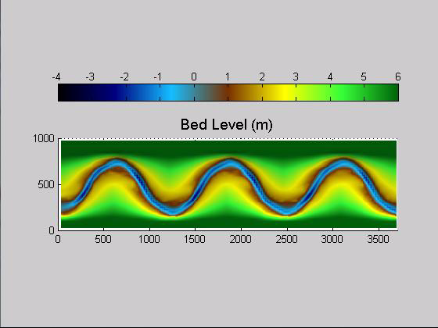
Source: Mijke van Oorschot, Deltares / UU
Notes:
An example how modelling can help us understand the “pristine” pattern of a river. By using models we can eliminate or add human pressures to help predict future developments of our river. Here an example of the work of Mijke van Oorschot modelling an artificial river reach inspired by the Allier River (France) in a time scale of 150 years.

Slide 10
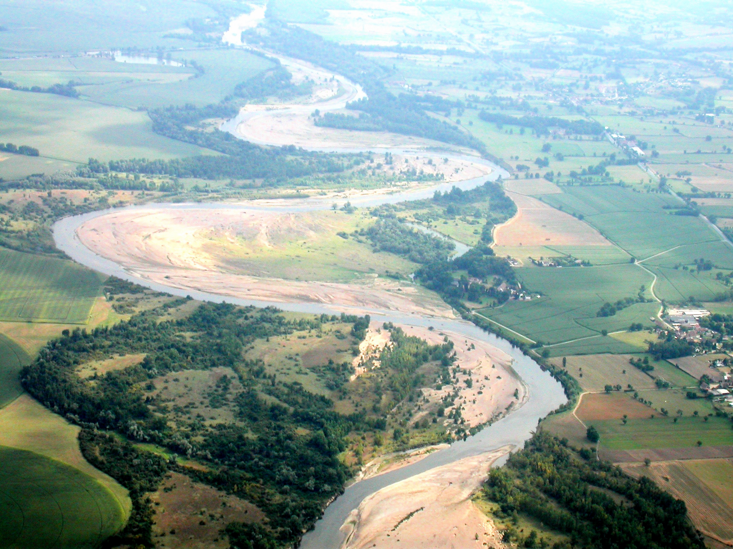
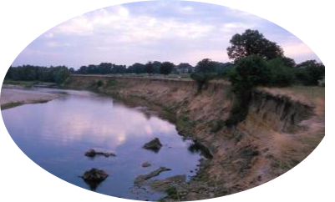
A natural river
A river is diverse in landscape types because of its dynamic nature.
Old elements dissappear while young elements are formed, this is called rejuvenation.
Pioneer
Old channels
Allier (France)
Notes:
The river reach features that can develop in a natural system are features like these landscape units. Although it is clear that this system also has been altered by humans.

Slide 11
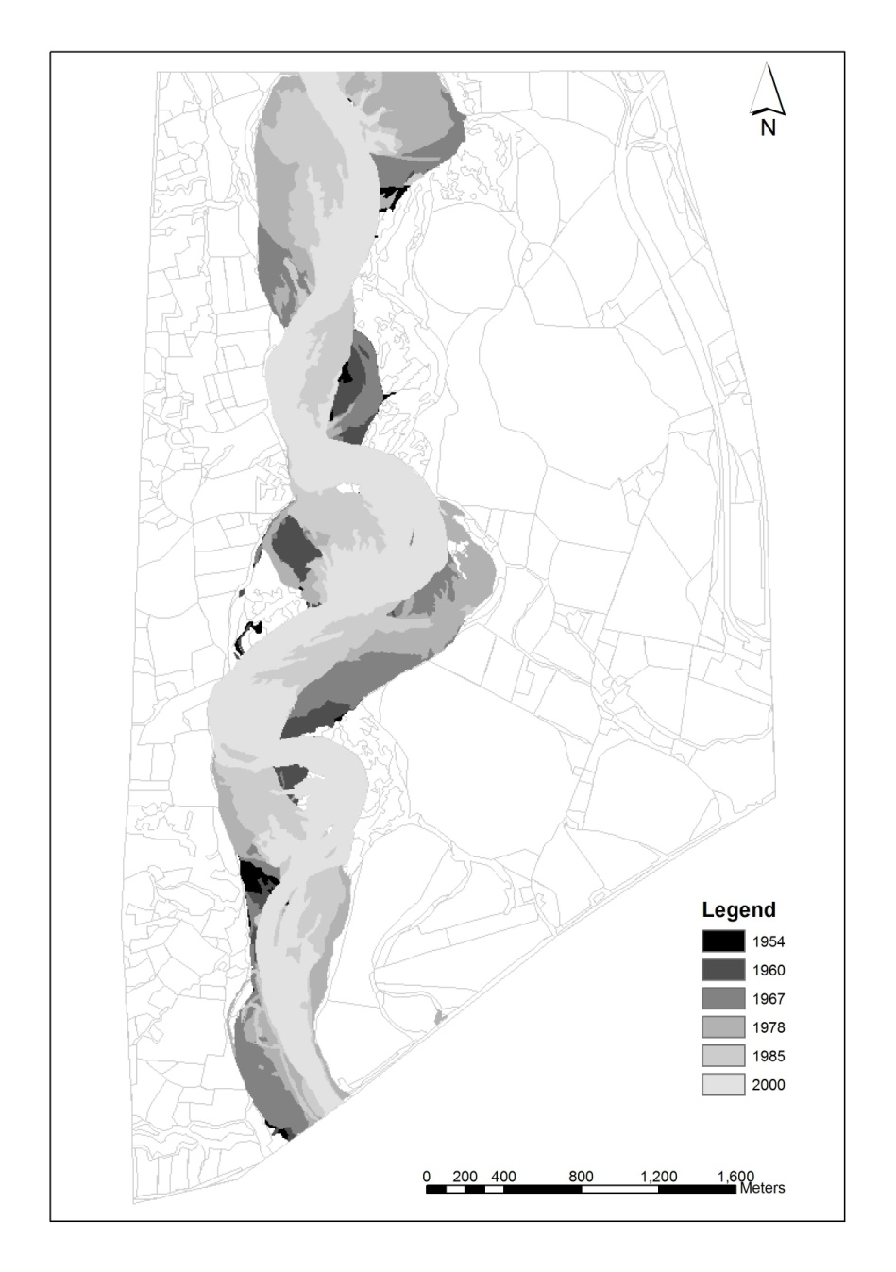
Mozaïc of old and young
Spatial distribution of floodplain age.
Age distribution of floodplain area in years
Geerling, G. W. G., Ragas, A. M. J., Leuven, R. S. E. W., van Den Berg, J. J. H., Breedveld, M., Liefhebber, D., & Smits, A. J. M. (2006). Succession and rejuvenation in floodplains along the river Allier (France). Hydrobiologia, 565(1), 71–86.
Geerling et al. 2006. Hydrobiologia
Notes:
One of the indicators of river dynamics can be the distribution of floodplain landscape age. Here you see the spatial and temporal distribution of floodplain area of a reach of the river Allier (France). Half of the (mapped) floodplain is younger than 15 years, while a quater is older than 46 years (oldest areal photos were 46 years old).

Slide 12
THE REFORM FRAMEWORK: 3. ASSESSMENT
I: RIVER TYPE. What does my reach look like?
II: WITHIN REACH FEATURES.
Are features appropriate for the hydromorphological river type and in good condition?
III: CATCHMENT TO REACH PROCESSES
How is the reach affected by larger-scale influences?
Region
Catchment
Landscape unit
Segment
Reach
Geomorphic unit
Hydraulic unit
River element
Source: REFORM Summer school lecture A. Gurnell
Notes:
Angela Gurnell: “Within-reach features are assessed to evaluate past and present hydromorphological condition of the reach (river-riparian-floodplain), and the degree to which condition is and has been affected by human actions within the reach.”

Slide 13
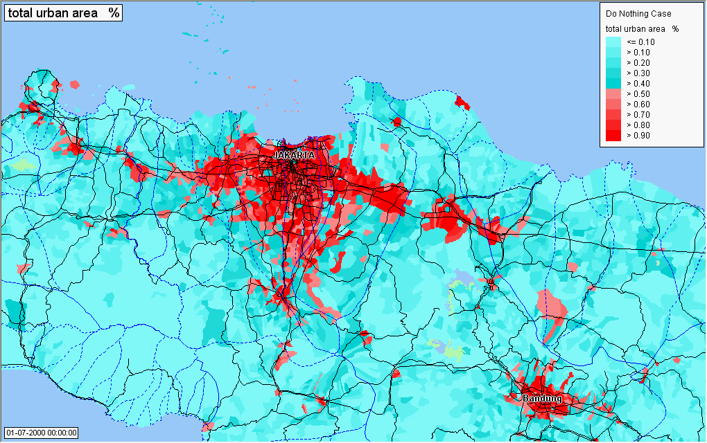
Example changing catchments - urbanisation
Notes:
As an example how dynamic a catchment scale can be, the projected urbansation of Jakarta under the autonomous development scenario from 2000-2020.

Slide 14
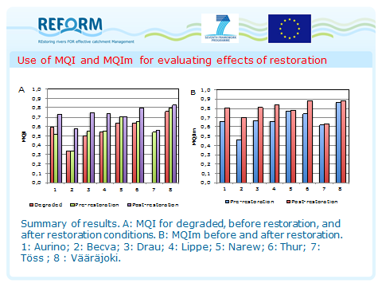
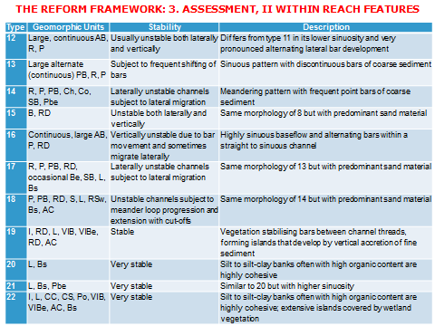
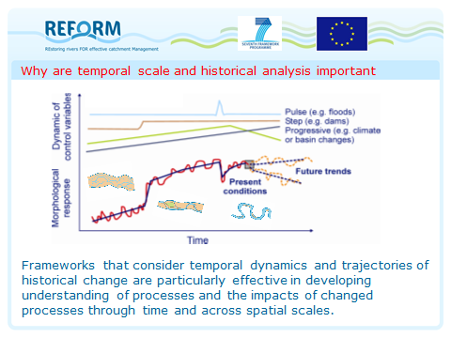
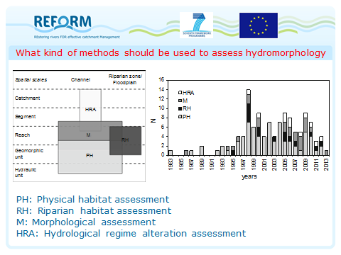
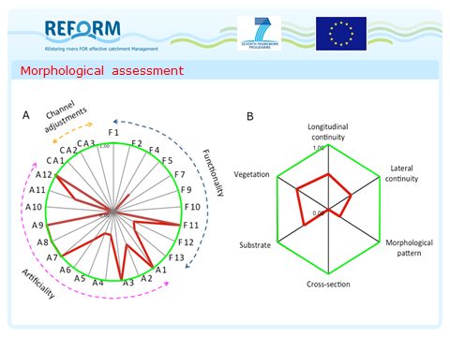
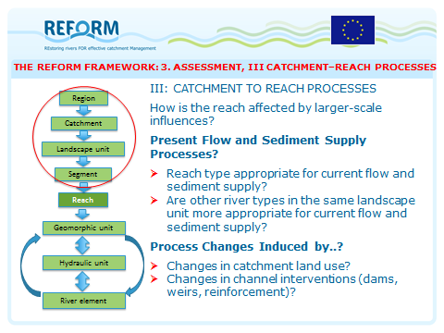
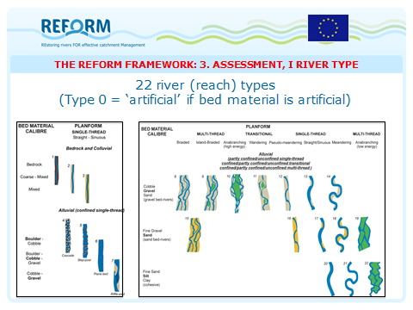
Notes:
The HYMO framework is daunting. Many parameters to be measured on many scale levels, and everything is related and linked to each other!!!!

Slide 15

Angela’s and Massimo’s total perspective vortex (Hitch Hikers Guide to the Galaxy)
Image of Hitch Hikers Guide
Removed because of copyright reasons
wiki.reformrivers.eu
Notes:
Douglas Adams, the writer of the Hitch Hikers Guide to the Galaxy, wrote about the Total Perspective Vortex as the ultimate in torturing people. The machine exposes the individual briefly to everything that has happened, is happening and will happen in the universe, in one flash. This causes most creatures to go absolutely mental. However this is similar to what the REFORM framework proposes, understand everything on multiple scale levels of past, present and future ;-) River restoration is a form of torture.

Slide 16
THE REFORM FRAMEWORK: INPUT TO DESIGN
Questions to answer in context of management / rehabilitation design:
  To what extent can reach interventions be removed (in channel, in riparian margins)?
  To what extent can natural processes to the reach be reinstated (catchment and local)?
  How may processes change in the near future (catchment and local scenarios)?
  Given question 1 to 3, is current reach type the most sustainable option or is another type (of those present within landscape unit) more appropriate?
  Design rehabilitation to allow river to recover its form and function as far as is possible given human constraints.
Source: REFORM Summer school lecture A. Gurnell
Notes:
Key Questions for the river managers, showing the kind of information that can be gathered from the REFORM HYMO FRAMEWORK.
The REFORM framework, briefly overviewed in the previous slides, allows river managers to answer a series of important questions when considering the most sustainable approaches that could be adopted in relation to river management and rehabilitation design in their catchment.

Slide 17
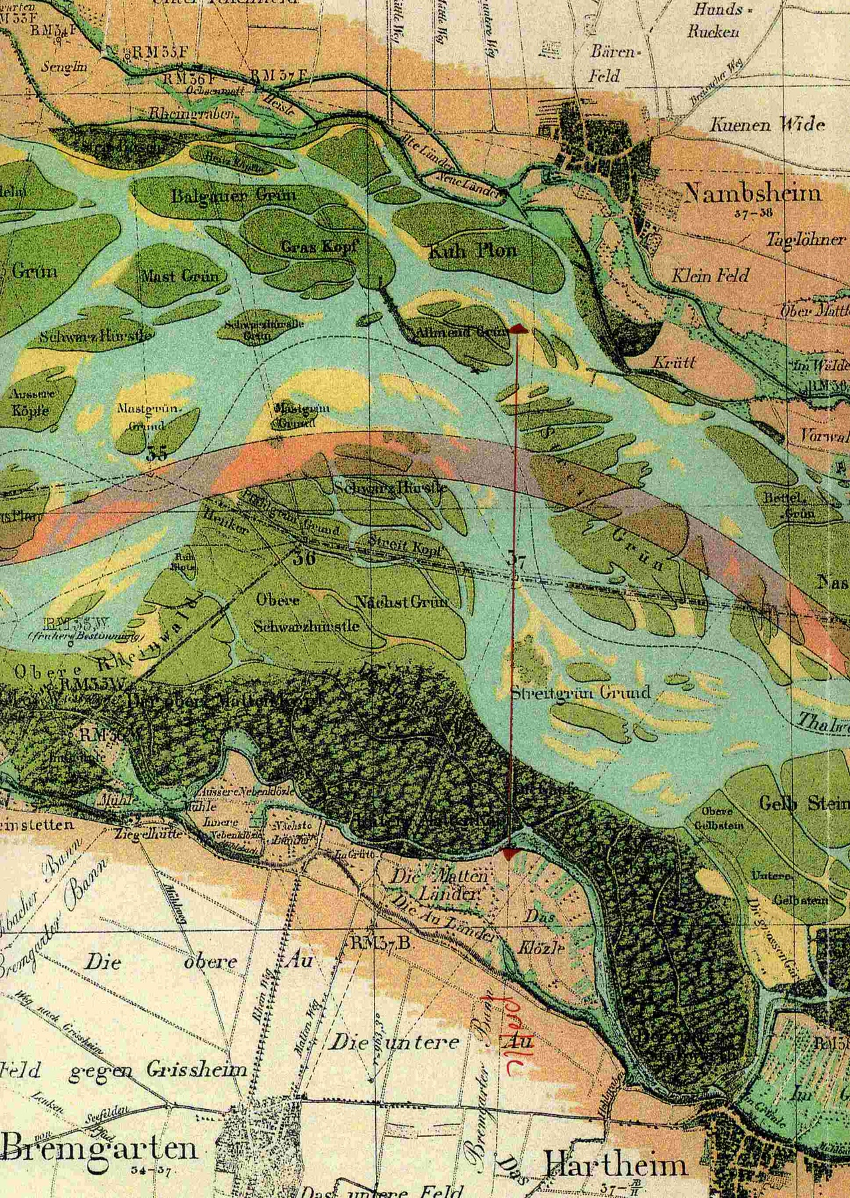
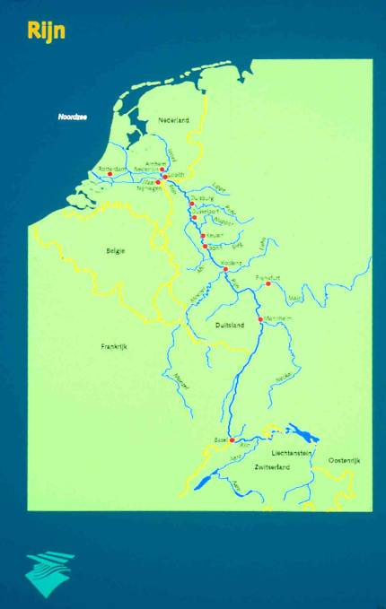
River Rhine
The river’s length is shortened by 100 kilometres in this section.
Within 100 years the floodplain area is reduced from 1000 km² to 130 km².
Section Basel - Karlsruhe
Notes:
An example of past changes and present/future opportunities is the channelized section of the rhine river, now called the Rest Rhine. The image on the right shows the planform in 1800’s and the present day course of the river (red line).

Slide 18
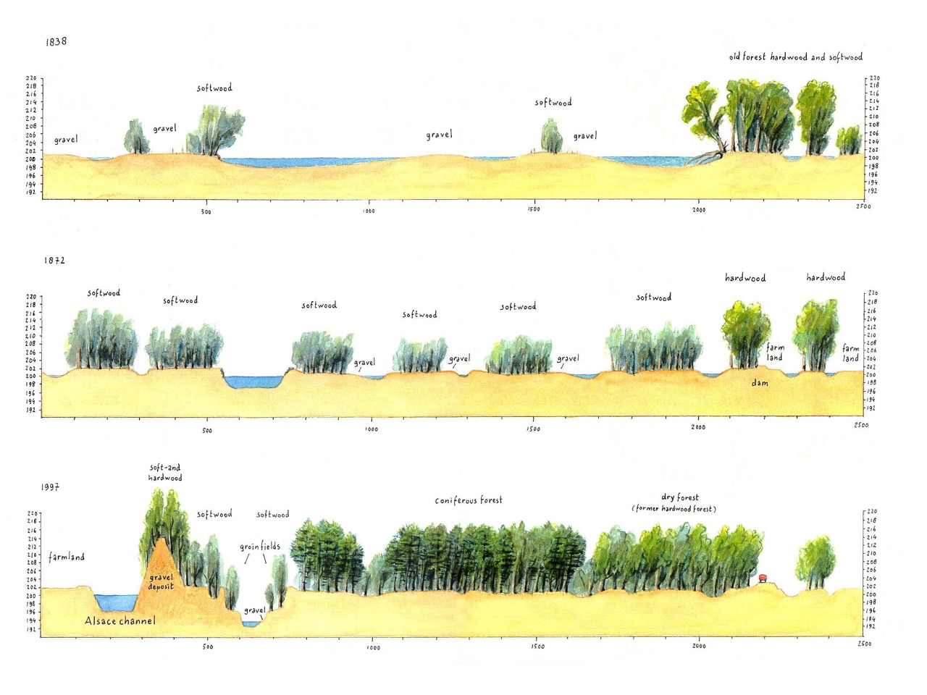
1838
1872
1997
Peters, B., Dittrich, A., Stoesser, T., Smits, A. J. M., & Geerling, G. W. (2001). The Restrhine: new opportunities for nature rehabilitation and flood prevention (p. 95). Nijmegen, Karlsruhe.
Notes:
The cross sections show the changes in plan form over time. A anastomosing river bed is transformed in a main channel with abandoned side channels (1872). Eventually the abandoned side channels became a forest with an incised river bed. Additionally a side canal has been dug, and the former river bed only receives about 50 m3/s and floods above 1400 m3/s.
Peters, B., Dittrich, A., Stoesser, T., Smits, A. J. M., & Geerling, G. W. (2001). The Restrhine: new opportunities for nature rehabilitation and flood prevention (p. 95). Nijmegen, Karlsruhe.

Slide 19
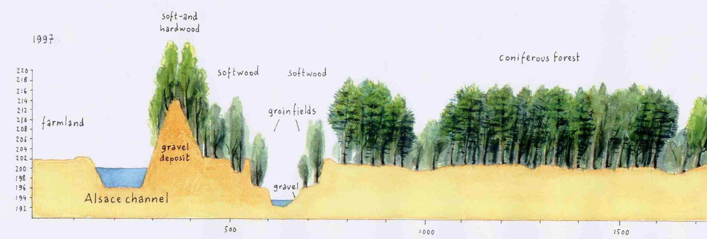
Upper Rhine case: Rest-Rhein
Present day situation: left navigation, right retention function
Navigation
‘Rest’ discharge

Slide 20
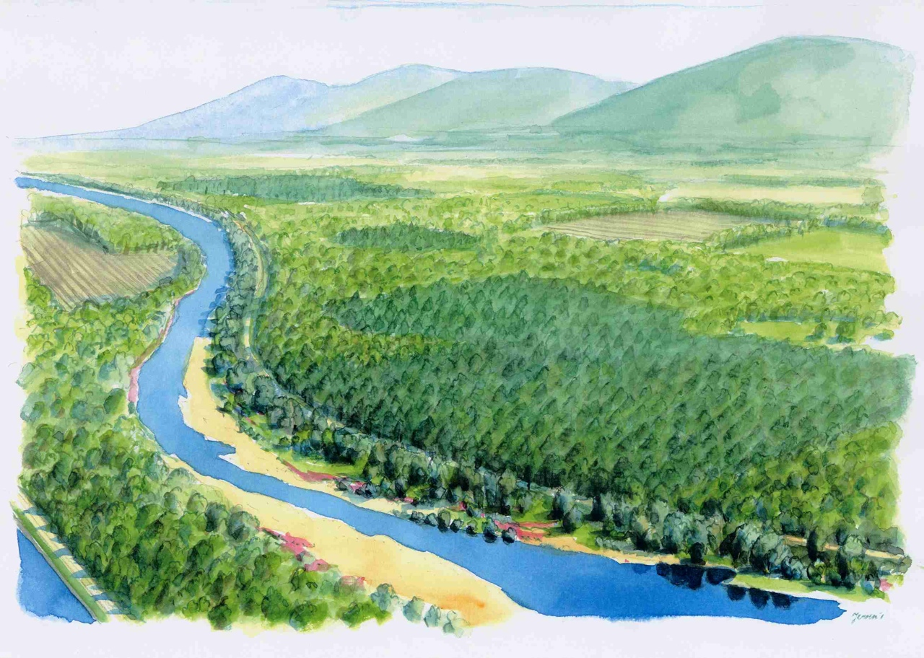
Present day: canal navigation, old river bed with groins only has
retention function

Slide 21
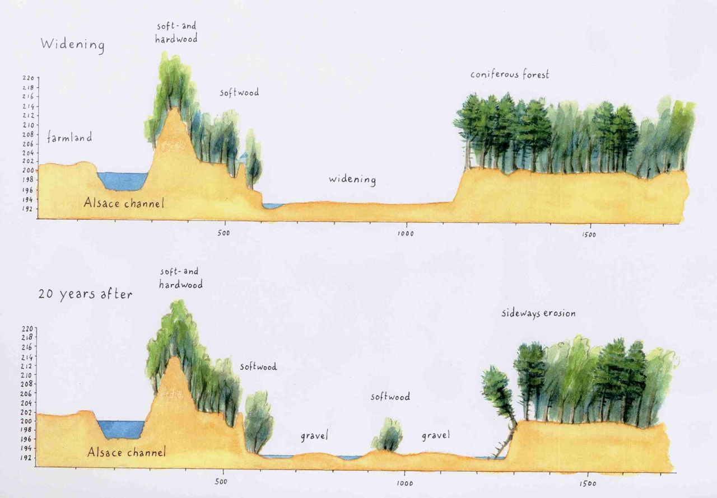
Notes:
Proposed is to use the processes that are still present to shape the landscape. The old groins will be removed, the river bed widened to the landscape becomes connected again. Ultimately a form of multi channel system might reappear. (Model assisted computations “promised” enough stream power that the courser sediment will move). See: Peters, B., Dittrich, A., Stoesser, T., Smits, A. J. M., & Geerling, G. W. (2001). The Restrhine: new opportunities for nature rehabilitation and flood prevention (p. 95). Nijmegen, Karlsruhe.

Slide 22
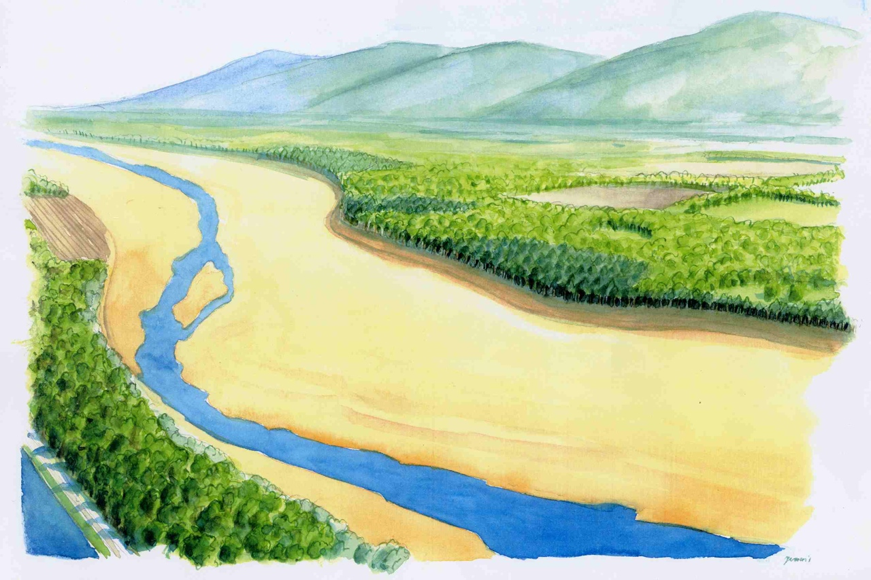
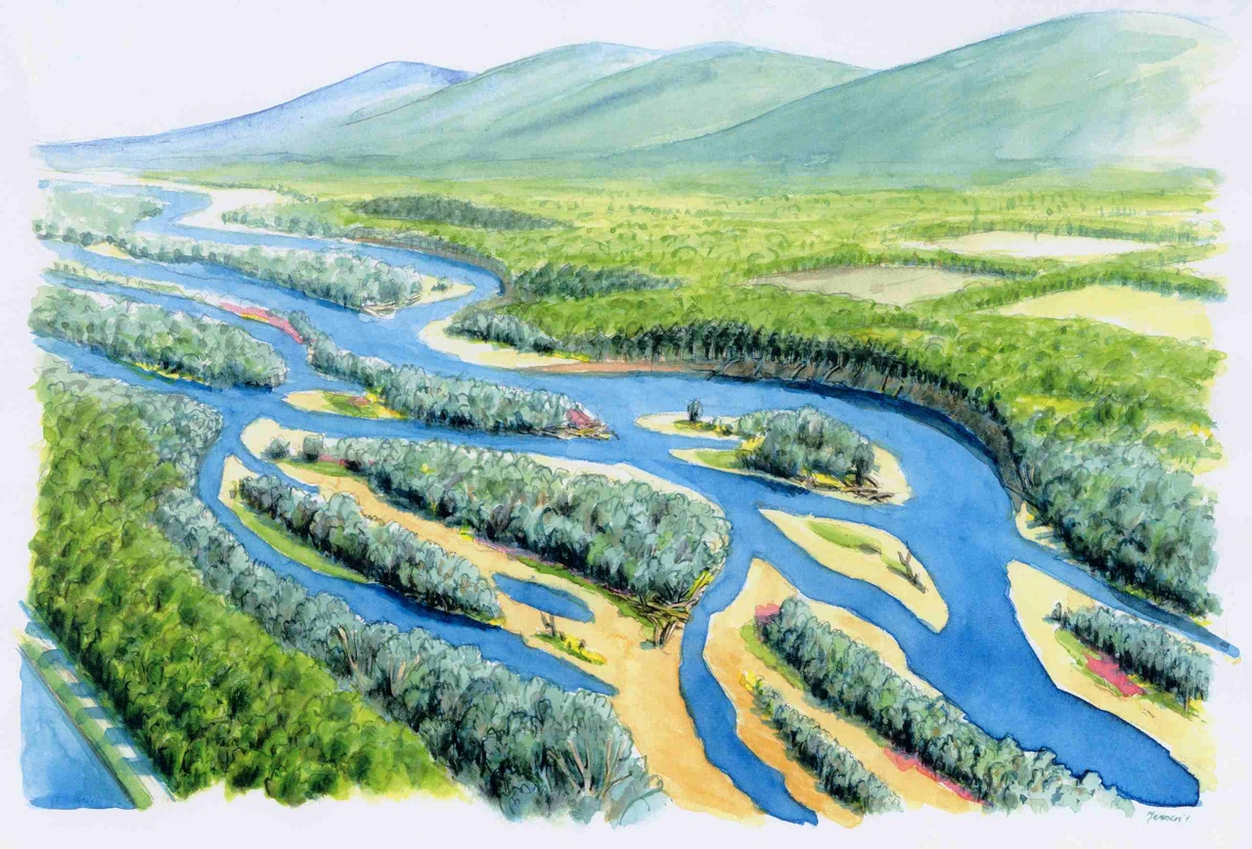
Human constraints allow for channel dynamics,
although under different HYMO regime.
Notes:
Artist impressions of the end result of the rehabilitation. A multi channel set, that has the power to rejuvenate its own vegetation (willows).
More examples of REFORM reference case studies can be found on: http://wiki.reformrivers.eu/index.php/Category:Case_studies

Slide 23
Notes:
The next step “What’s Wrong?” comprises the assessment of found river conditions to what extent the river has been altered.

Slide 24
DPSIR: Driver – Pressure – State – Impact – Response
Image of driver, pressure impact removed for possible copyright reasons.
Notes:
The DPSIR app roach is one of the tools that can be used to systematically describe the Driver, Pressures, State, Impact and Response of the river reach. Especially the pressures – state to impact relation is the main part of this “What is wrong?” section of the catchment planning approach. Pressures – state describe the river without valuing the system. The choice of impact is subjective, depends on what humans see as an impact, and is for example determined by the water framework directive or lists of threatened species.

Slide 25
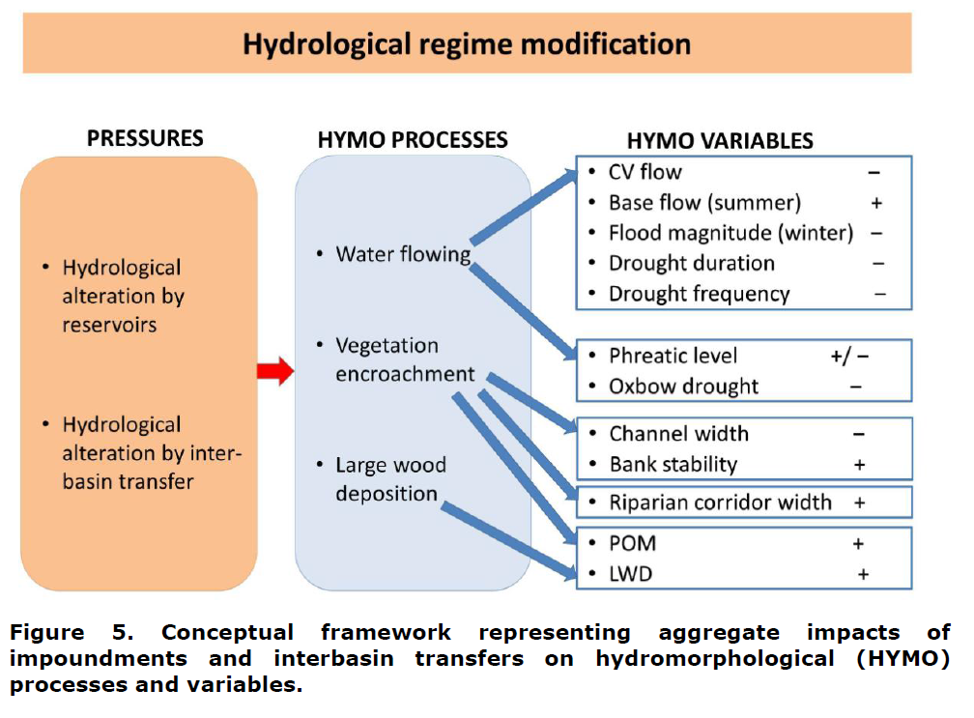
Pressure effects on processes and HYMO variables
From: REFORM Deliverable D1.2 Effects of pressures on hydromorphology. Review on pressure effects on hydromorphological variables and ecologically relevant processes. Author(s) Diego Garcia de Jalón et al., 2012.
Notes:
REFORM deliverable 1.2 gives an overview of the possible links between pressures, hymo-processes and hymo variables. Here an example of hydrological regime modification. See: http://www.reformrivers.eu/deliverables/d1-2

Slide 26
Pressures (wiki)
Wiki: pressures and links to case studies
P01 | Surface water abstraction
P02 | Groundwater abstractions
P03 | Discharge diversions and returns
P04 | Interbasin flow transfers
P05 | Hydrological regime modification
P06 | Hydropeaking
P07 | Reservoir flushing
P08 | Sediment discharge from dredging
P09 | Artificial barriers upstream from the site
P10 | Artificial barriers downstream from the site
P11 | Colinear connected reservoir
P12 | Impoundment
P13 | Channelisation / cross section alteration
P14 | Alteration of riparian vegetation
P15 | Alteration of instream habitat
P17 | Embankments, levees or dikes
P18 | Sedimentation and sediment input
P19 | Sand and gravel extraction
P20 | Loss of vertical connectivity
P21 | Other pressures
Notes:
The list of pressures in the wiki is a result of an international working group in a previous EU project (Forecaster). The pressures for every case study in the REFORM wiki have been checked, so, by looking at one case study it is easy to find other cases with the same pressure.

Slide 27
Monitoring
Goal
Scale
In practice inconsistency in:
goals
variables
methods
time period
location
data on final project implementation
..
Cartoon removed because of possible copyright reasons.
Notes:
Monitoring is a big issue for river managers as it costs money after the measure is carried out. Or, in case of system monitoring, the benefits are very indirect. Often its importance is overlooked or its implementation lacks consistency and seems ad hoc for separate project. In dealing with river authorities, you cannot stress enough the importance for monitoring.

Slide 28
Indicators in REFORM
HYMO
Degradation assessment method
Potential
links
Realised
links
Possible
indicators
Recommen-dations
Ecology
Examples along a degradation gradient
(4 classes corresponding to good to bad)
Examplified from the reach (to stretch scale)
Use the process-oriented HYMO assessment methods
Fish best indicator
Use of traits
New indicators
Source: REFORM presentation N. Friberg
Notes:
Ecological indicators that can express HYMO pressures and measures in an clear ecological response are also subject of study in REFORM. The scheme above shows the objective of the workpackage 3. First possible links between ecology and hymo are researched. The realised links are expressed in indicators, leading to a set of recommendations of which indicators are applicable in combination with which hymo degradation indicator.
See:
http://www.reformrivers.eu/deliverables/d1-3
http://www.reformrivers.eu/results/effects-of-hydromorphological-changes

Slide 29
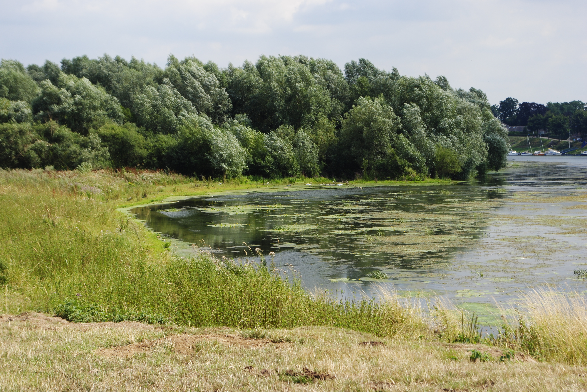
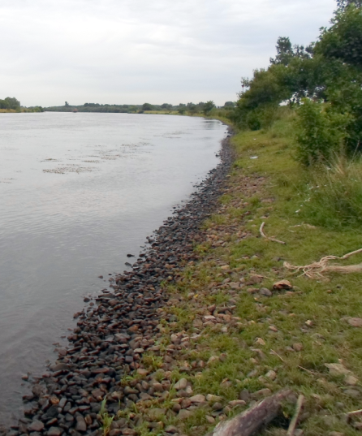
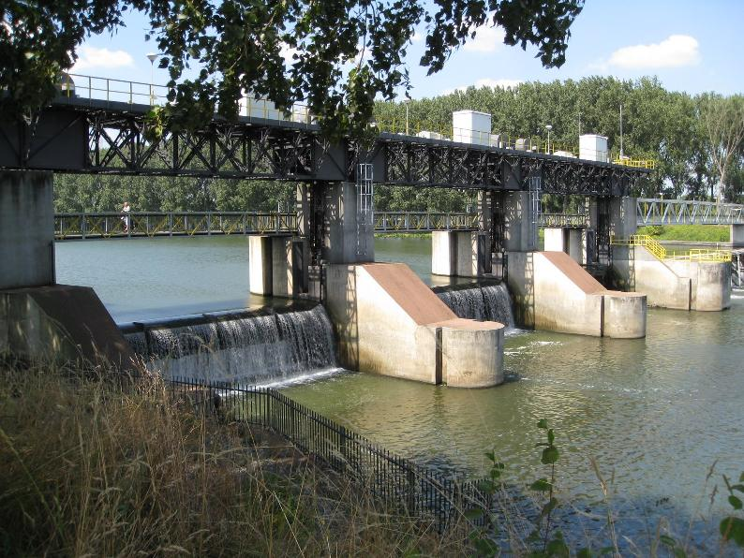
Indicators
Notes:
A nice example of a self-restoring river within a current HYMO context (impounded). A major flood crossed the floodplain here. That process restored a gentle sloping shoreline and deposited bare sediment on the shore. This pioneer site was colonised by Willow (a pioneer species) and the shallow shoreline area was colonised by aquatic vegetation, typical for a non- or poor-flow regime. However, the water framework quality indicator on which this is judged, is geared to flowing rivers, not impounded. So, this site scores low.

Slide 30
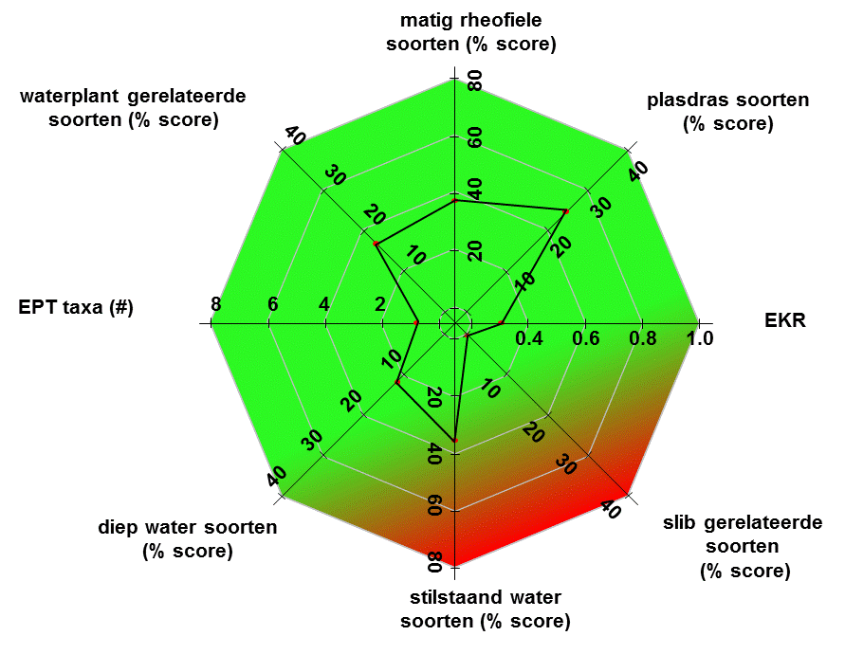
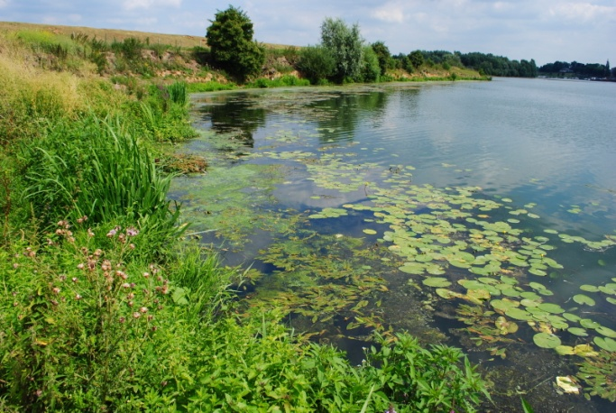
Example – WFD indicator for rivers wrong indicator?
Medium rheophilic species(% score)
WFD Index for rivers used in impounded sections
Macrophyte related species (% score)
Shallow water species (% score)
WFD index
Deep water related species (% score)
Silt related species (% score)
Stagnant water related species (% score)
Notes:
Here, a non REFORM result, showing the low WFD score of this rather unique self restored location. The WFD index score is based on species assemblages of flowing large rivers on sandy sediment. As this river is impounded, flow conditions are reduced. Can it still be classified as a river?

Slide 32
Measures classes
Measure Class
01. Water flow quantity improvement
02. Sediment flow quantity improvement
03. Flow dynamics improvement
04. Longitudinal connectivity improvement
05. River bed depth and width variation improvement
06. In-channel structure and substrate improvement
07. Riparian zone improvement
08. Floodplains/off-channel/lateral connectivity habitats improvement
09. Other aims to improve hydrological or morphological conditions
See for all measures: http://wiki.reformrivers.eu/index.php/Category:Measures
Notes:
Once the HYMO context of the reach is established and we have insight in the pressures that are present, we can start identifying possible goals (measure categories) for rehabilitation of the river reach. We don not go as for as to suggest individual measures yet (such as removing a weir), but identify the goal of the measure first, like flow dynamics improvement.

Slide 33
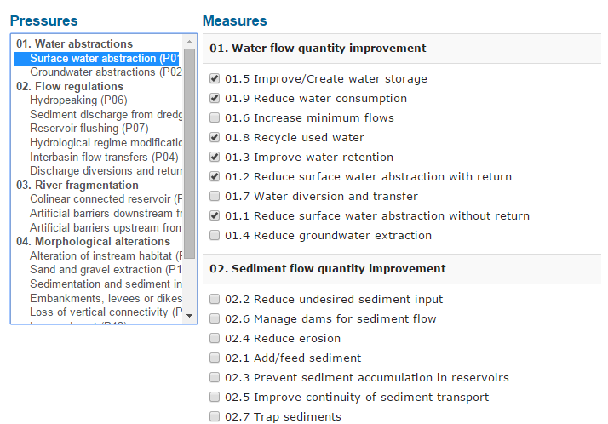
Pressure - Measure relations in wiki
Notes:
To help identify possible measures and measure categories, you will find pressure – measure relations in the wiki. Navigate to a certain pressure page, and you will find the linked measures below and vice versa. This example for surface water abstraction shows how the links are made in the database.

Slide 34
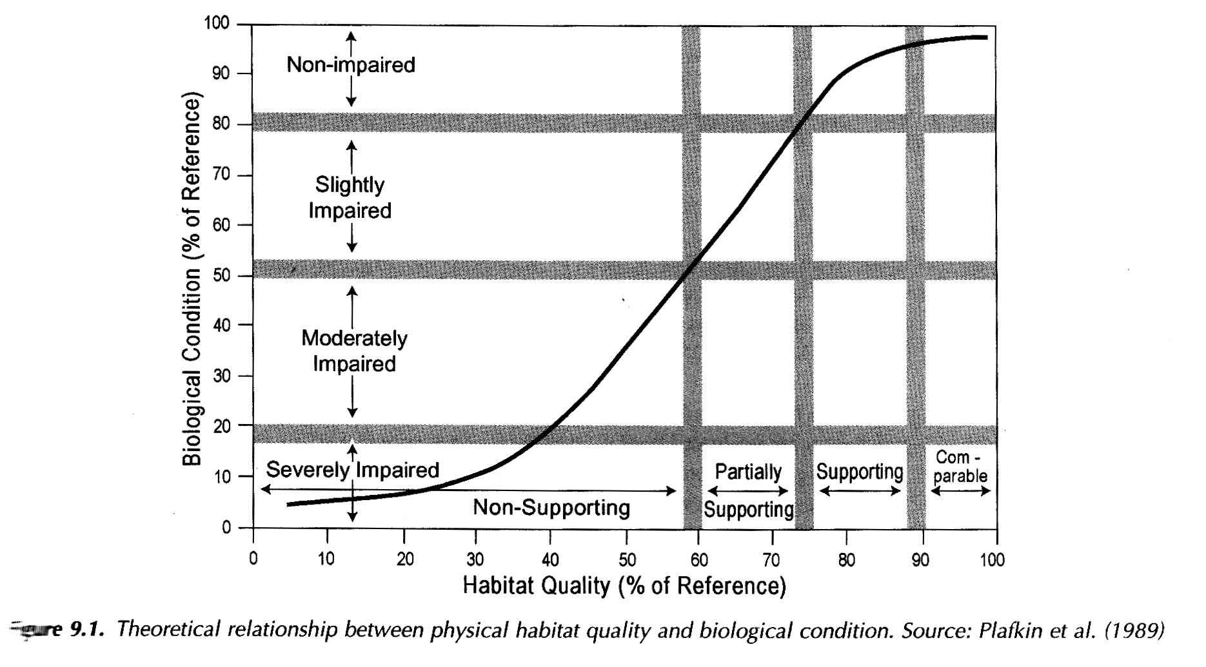
Question of the river manager: how much should we restore?
Notes:
One of the big questions of the river manager to us is often, how many measures to I need to take in a reach to be able to restore it? This is very difficult to say. By following the 4 key steps in the REFORM catchment planning, and most importantly by carrying out the River Characterisation Framework, you can at least make the best informed decisions as to plan effective measures and to minimize money wasted on useless measues.
Ongoing monitoring of reach status is needed to see if individual measures and the assemblage of measures have success. If not, re-enter the catchment planning cycle (although you don’t need to do the river characterisation again, only update the assessment with the measures carried out.

Slide 35
Catchment planning
The framework systematically guides practitioners through two main planning stages of river restoration: catchment planning and the project cycle
Notes:
Recap of the catchment planning cycle.

Slide 36
Planning programs of measures
Once pressures and measure categories are identified, we can move to more detail planning of measures
Notes:
Planning programmes of measures. When measure goals are clear for the river reach, you can enter the planning cycle to start detailed planning of the measures in the reach. This involves interaction with local stakeholders to which you present your assessement of their reach. Toghether you can identify possible measures, formulate the projects, get (co)financing, implement and don’t forget to budget for monitoring!

Slide 37
How? Tools provided in the wiki
The framework provides detailed information for each of the planning stages and offers tools and guidelines for users, some of which have been developed in REFORM.
Including:
Plan Check Do Act (PDCA)
Driver Pressure State Impact Response (DPSIR)
Logical Framework
SMART objectives (Specific Measurable Achievable Realistic Timely)
Multi Criteria Decision Analysis (MCDA)
Cost Benefit Analysis (CBA)
Notes:
Here a list of tools that have been elaborated in the REFORM project. You will find introductions and references on wiki.reformrivers.eu.

Slide 38
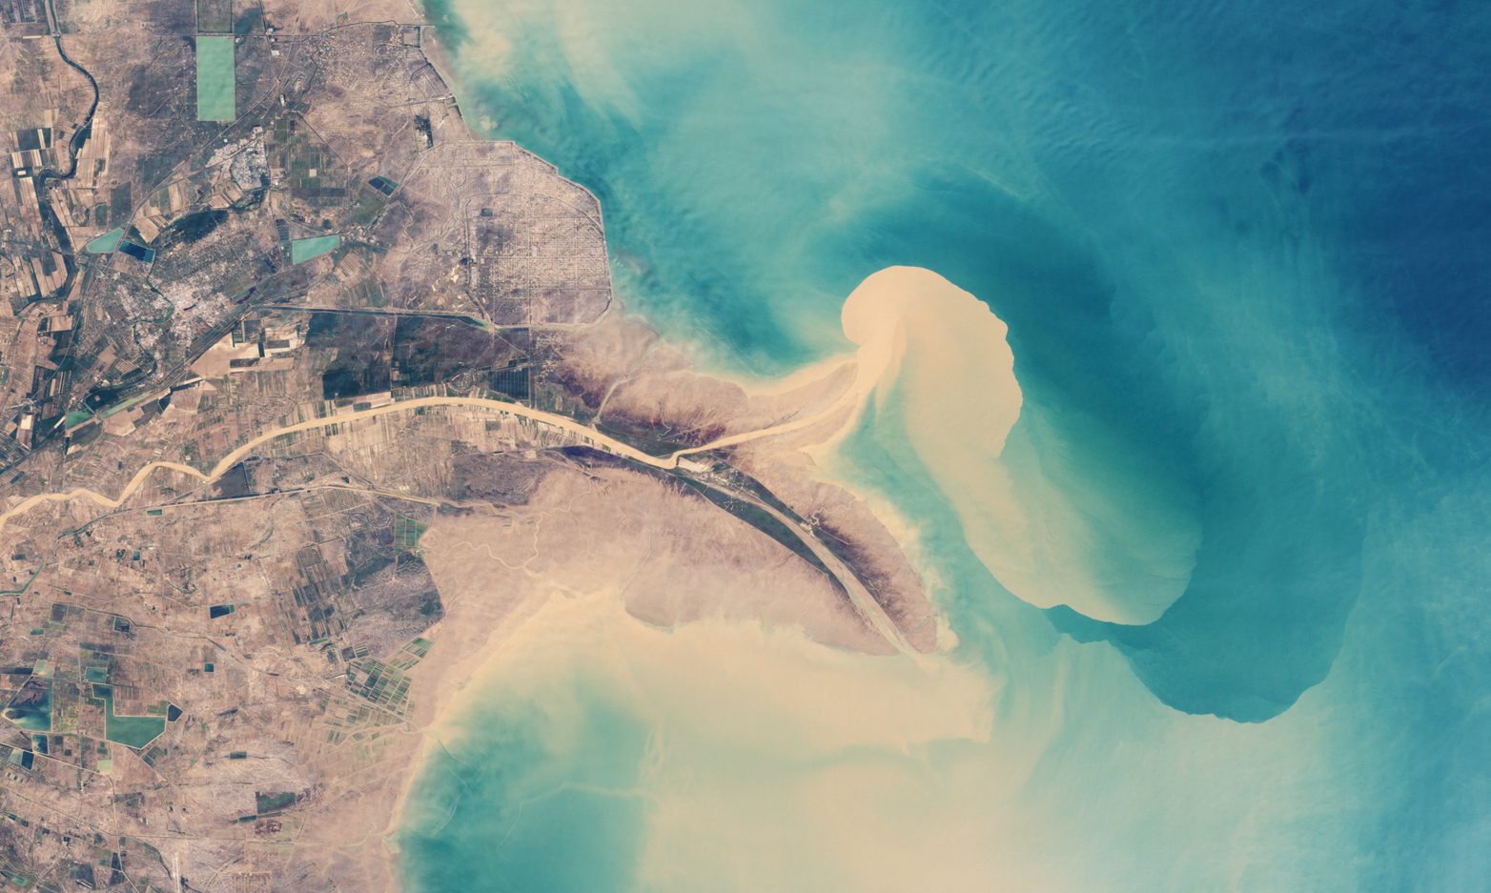
“Using natural processes” (Yellow River China)
Notes:
Comic relief: the Chinese diverted the flow of the Yellow River in a brand new river bed to steer coastal sedimentation. There are oil fields in the near coastal zone that will be terrestrial in some time by using Natural Processes somewhat different than in river restoration. However, the nature reservation sites, marshlands, along the old river bed (see dry river bed upper left) were suffering from lack of water and salt intrusion. The question to us was how to mitigate this.

